Slide 1
Using Pearson online accounts tutorial
September 2014
Pearson online accounts tutorial for English subject grade 7,8,9
Ms. Haya al dadah
English Coordinator

Slide 2
objectives
1. To gain understanding of using online learning and its importance in supporting learning.
2. To develop skills in using Pearson accounts for learning.
3. To increase the awareness of learning beyond text books and its role in supporting the quality of teaching and learning.

Slide 3
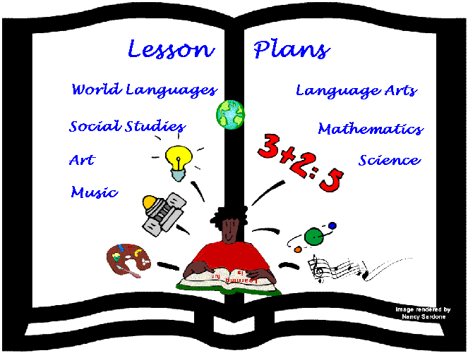
Pearson account
English subject
Grade 7,8,9
Use GOOGLE CHROME to open the main page:
https://www.successnetplus.com/

Slide 4
Chose log in

Slide 5
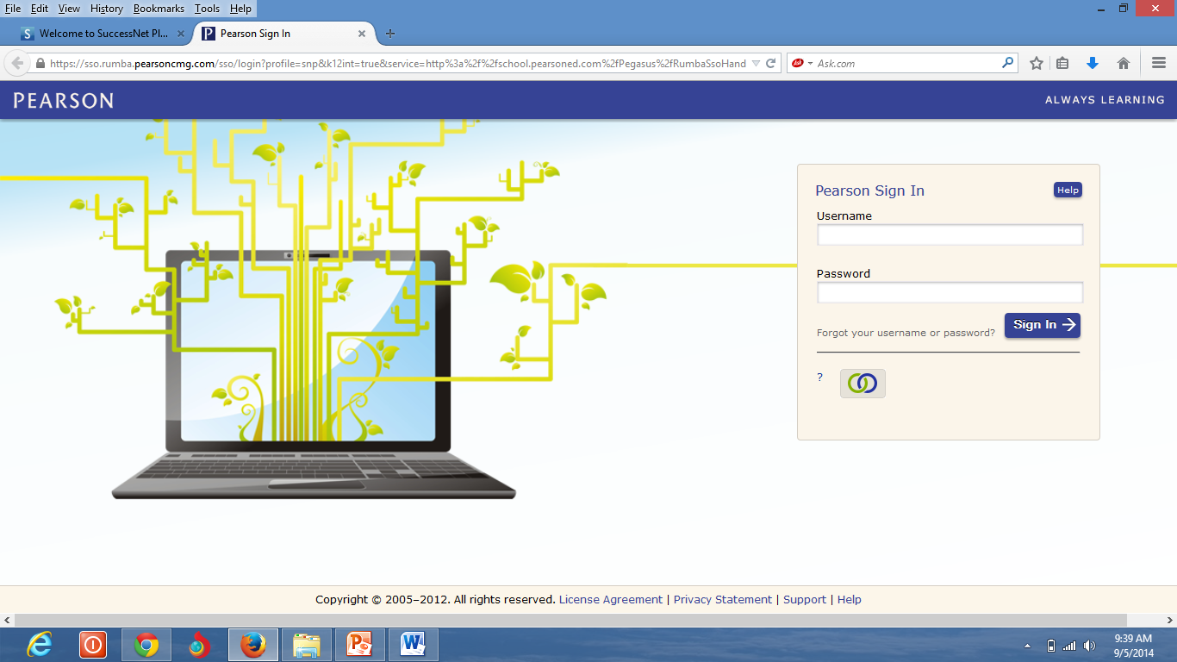
Insert your username and password

Slide 6
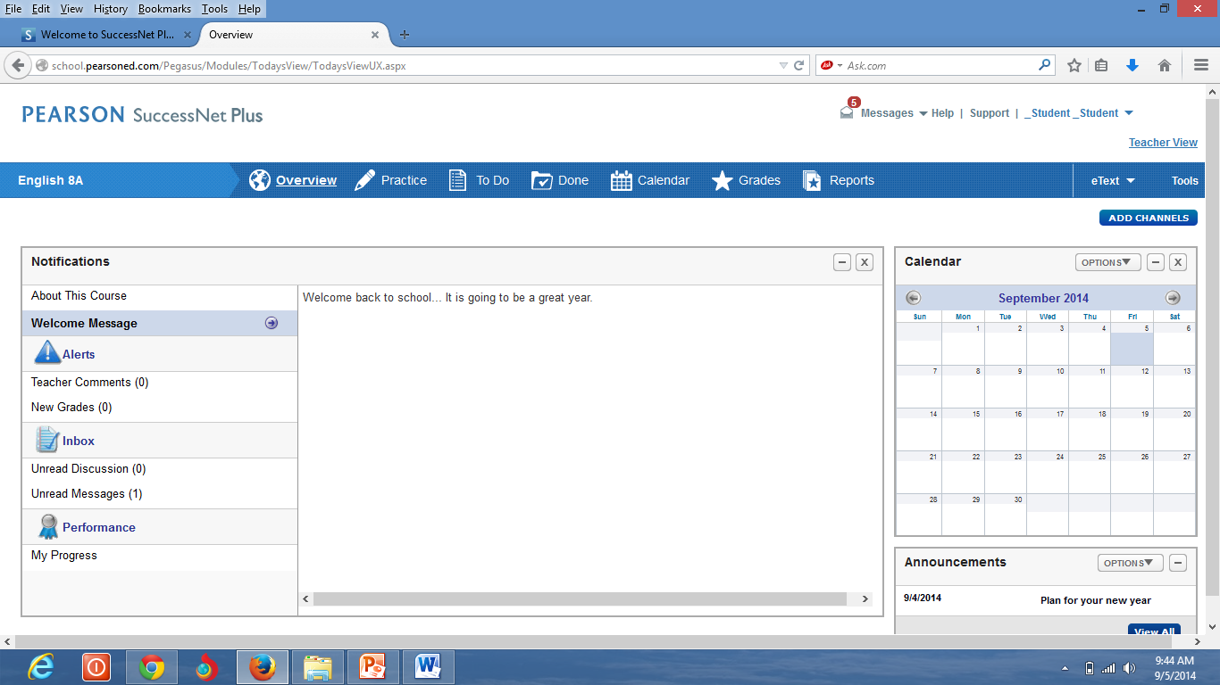
Messages from the teacher about the weekly plan and the homework.
Notes:
The success criteria is written in student friendly language for student use. Behavioral or learning objectives are generally written in teacher language for teacher use. Both are important and have very different uses.

Slide 7
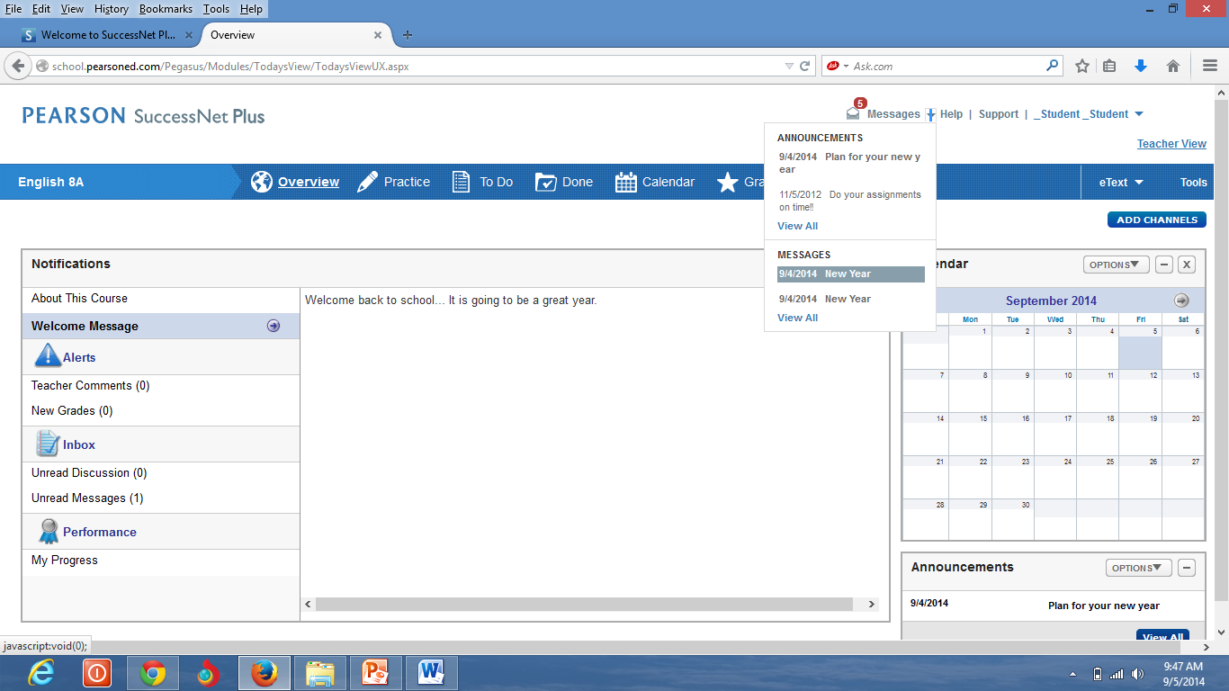
Click at the small arrow to see the messages from the teacher, then choose the message that you want to know and double click at it.
Notes:
Discuss the differences to connect to the unit on learning goals.

Slide 8
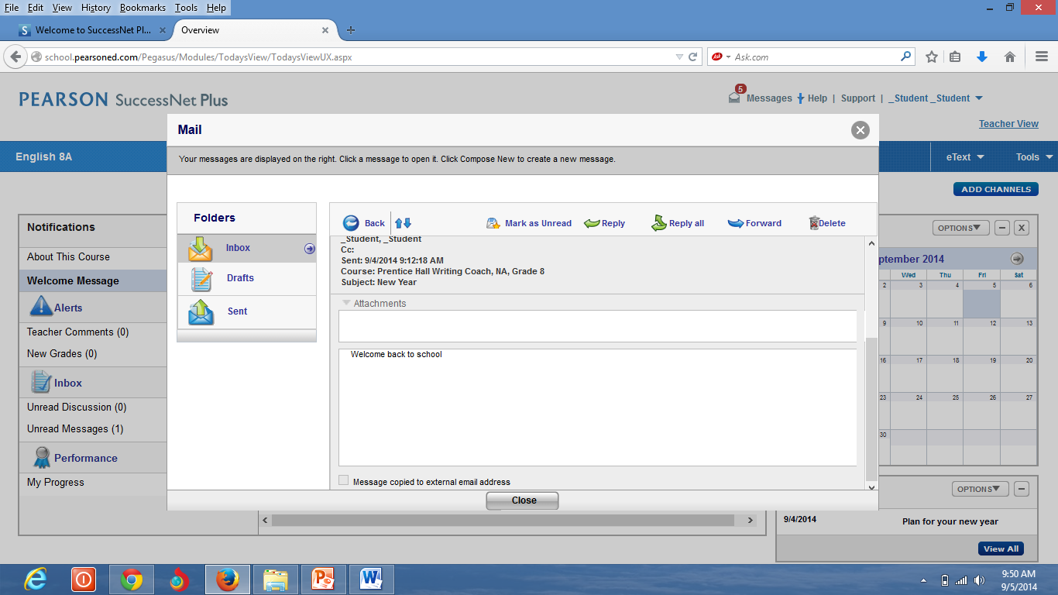
From the mail, you can receive and send mails to your teacher. You can find in the inbox the weekly plan and the homework.

Slide 9
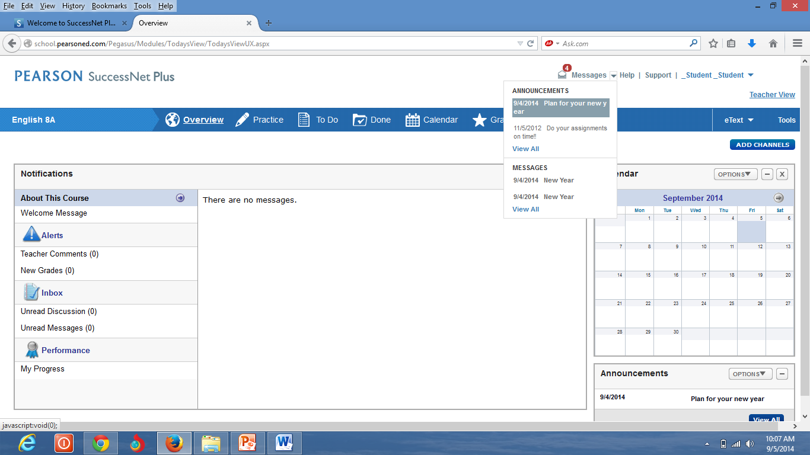
In this part , you will find the announcements from the teacher.
You can also find the announcement here.

Slide 10
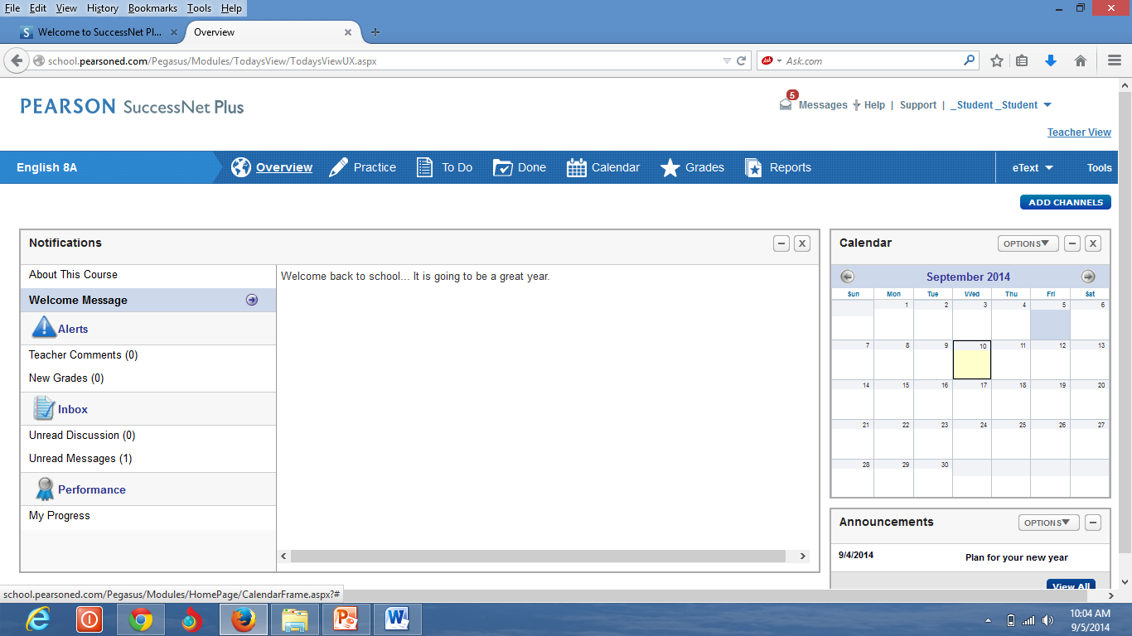
Welcome message from the teacher.

Slide 11
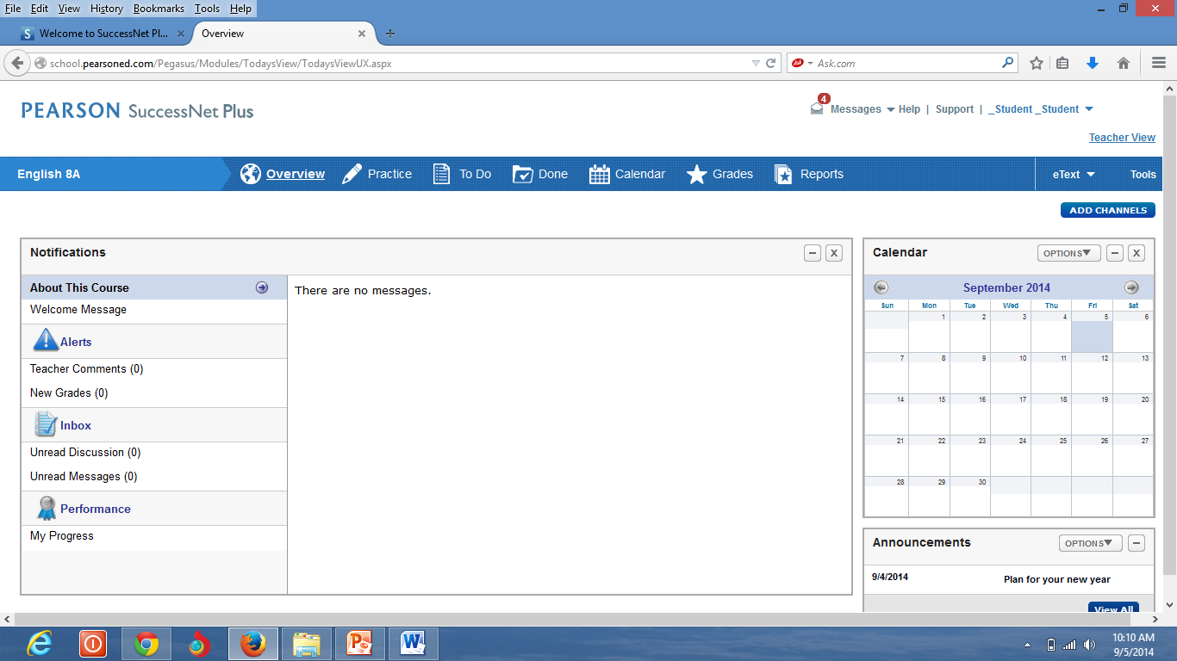
Information about the course.

Slide 12
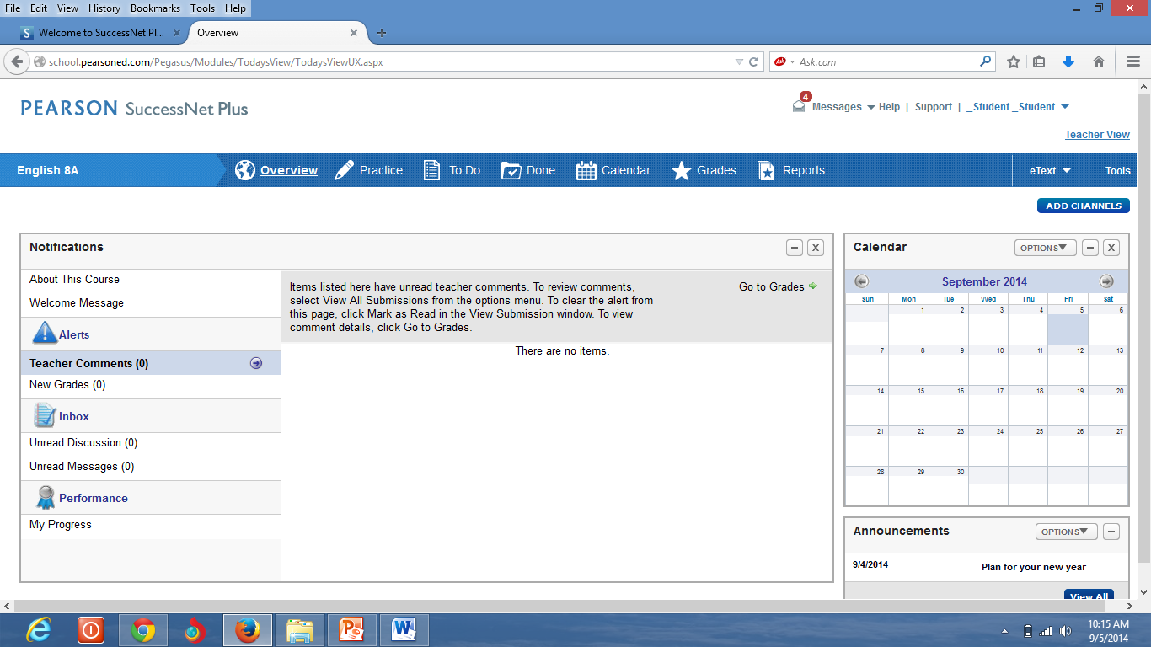
Read the comments from your teachers about your work and progress.

Slide 13
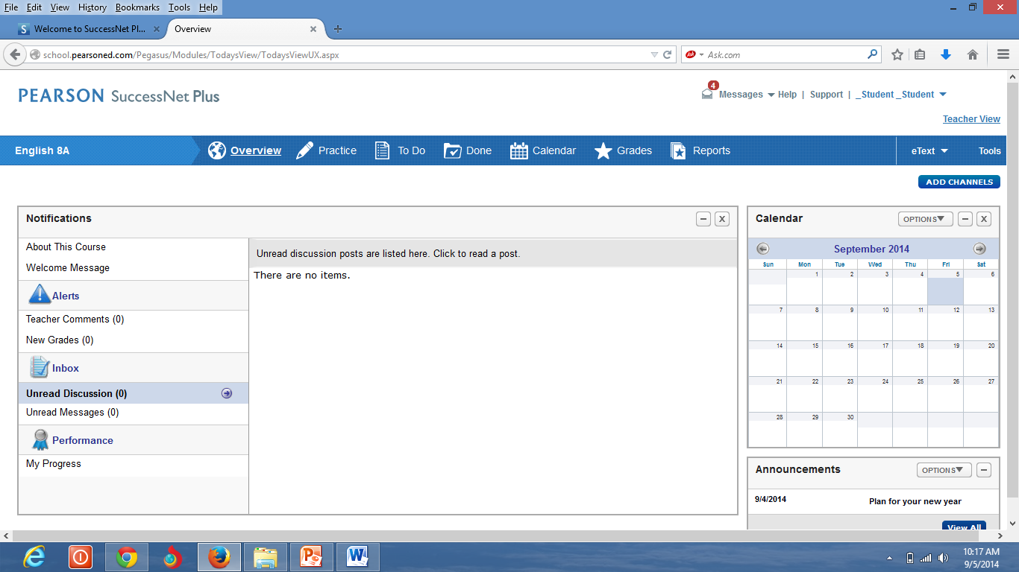
Read the new messages and discussion about the course.

Slide 14
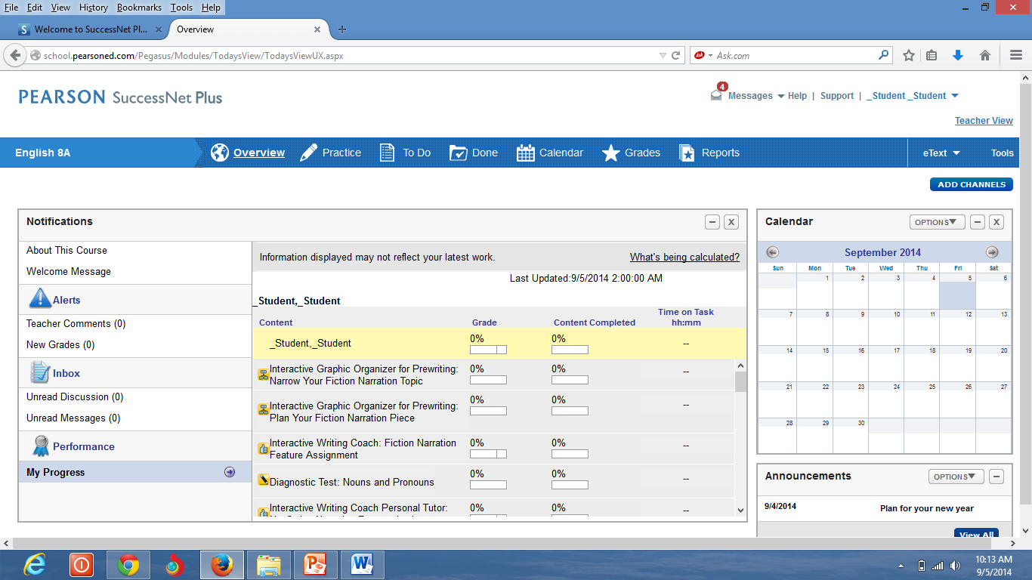
Reports about your progress in the course.

Slide 15
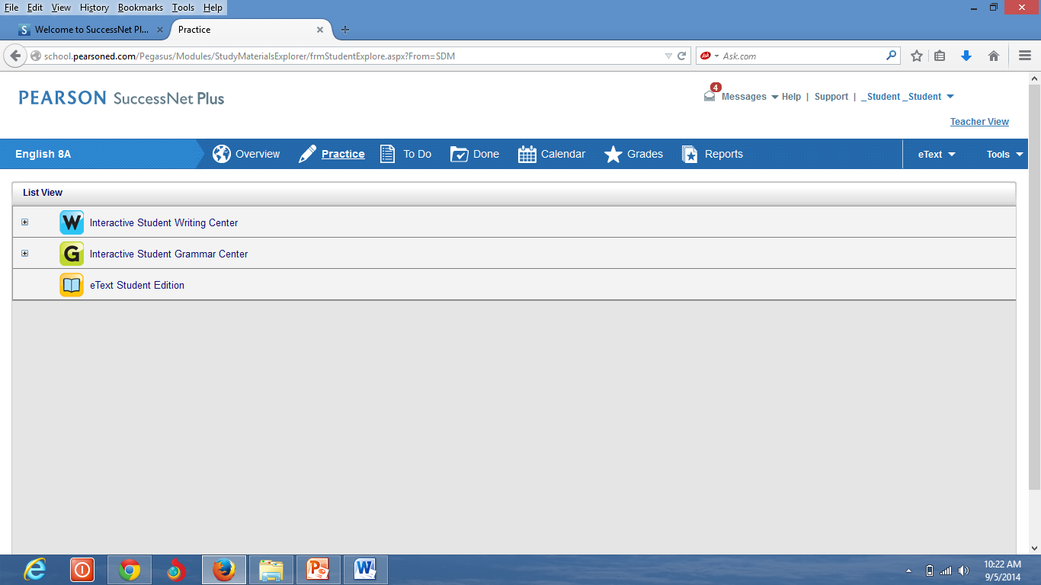
When you click at “practice ”, this window will appear.
Click at eText Student Edition in order to use it as a resource of information.

Slide 16
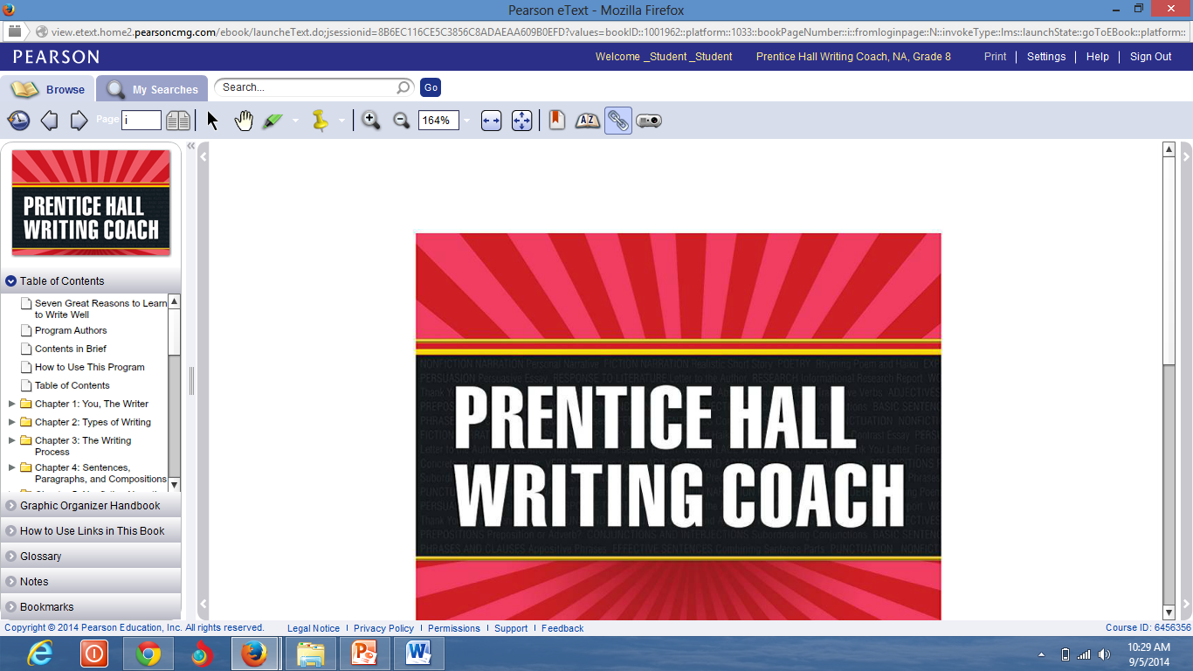
Student Edition Online Book that you can use it as an essential source of learning.

Slide 17
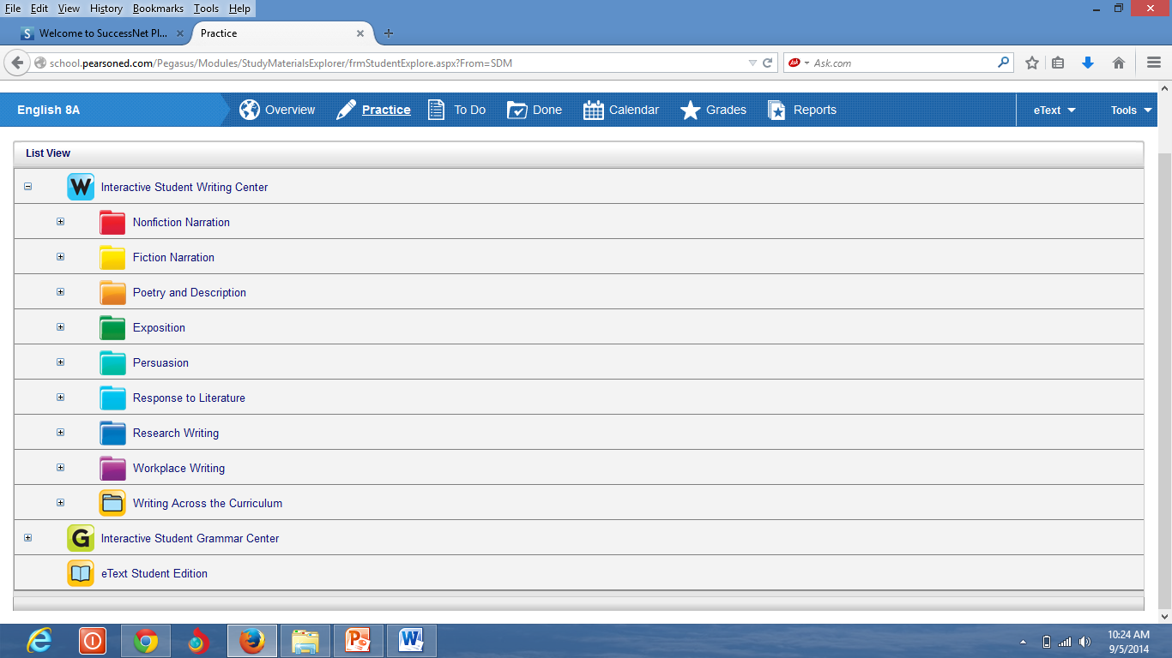
Click at Interactive Students Writing Center to practice the different kinds of writing.
Click at Interactive Students Grammar Center to practice the different kinds of writing topics of grammar.

Slide 18
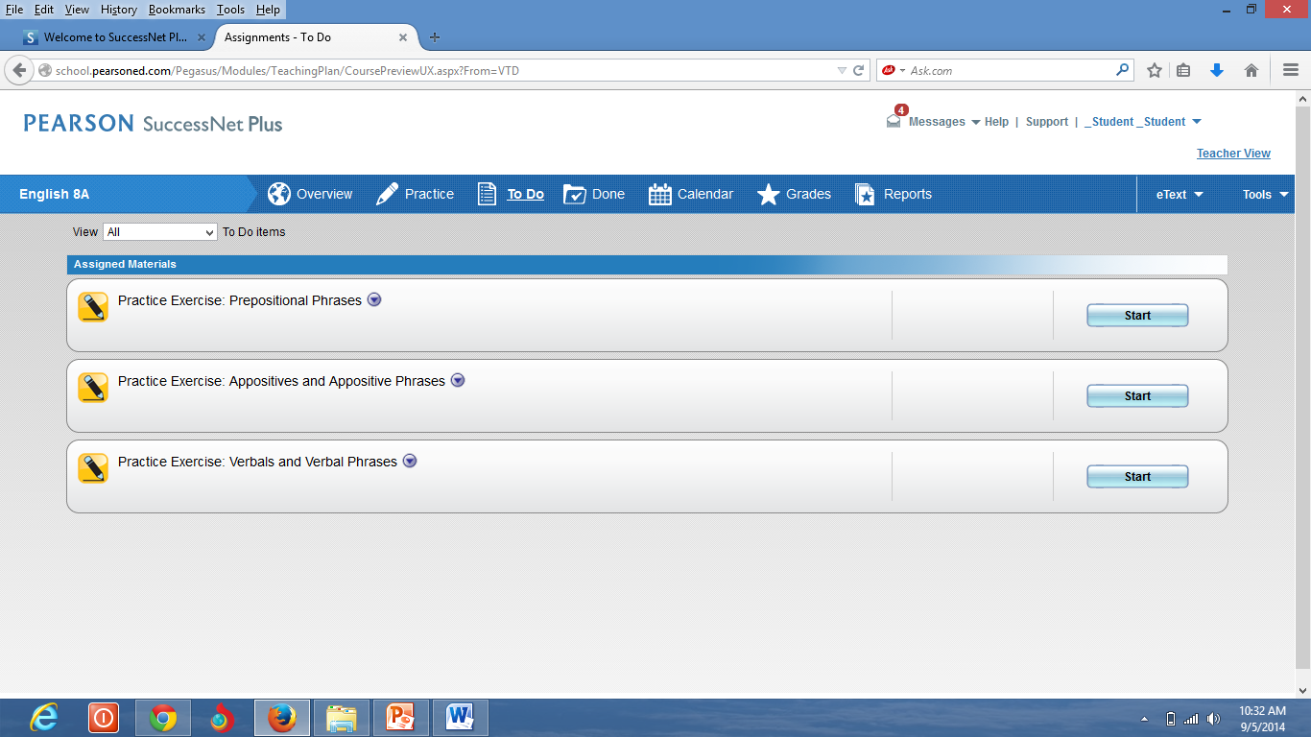
Click at “To Do” to find the assignments you should do in a specific time as it has a deadline.
Click at “Start” to start doing the assignments.

Slide 19
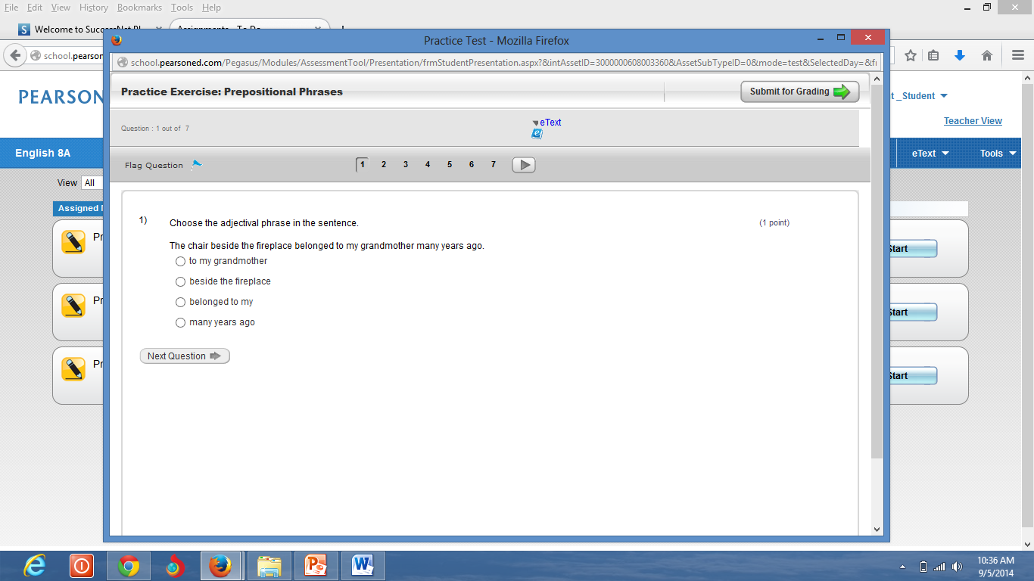
It is very important when you finish the assignment to click “Submit for Grading” so it will appear in the teacher`s account that you did the assignment, and your mark will be sent to the teacher`s account.
Answer the question, then click “Next Question”.

Slide 20
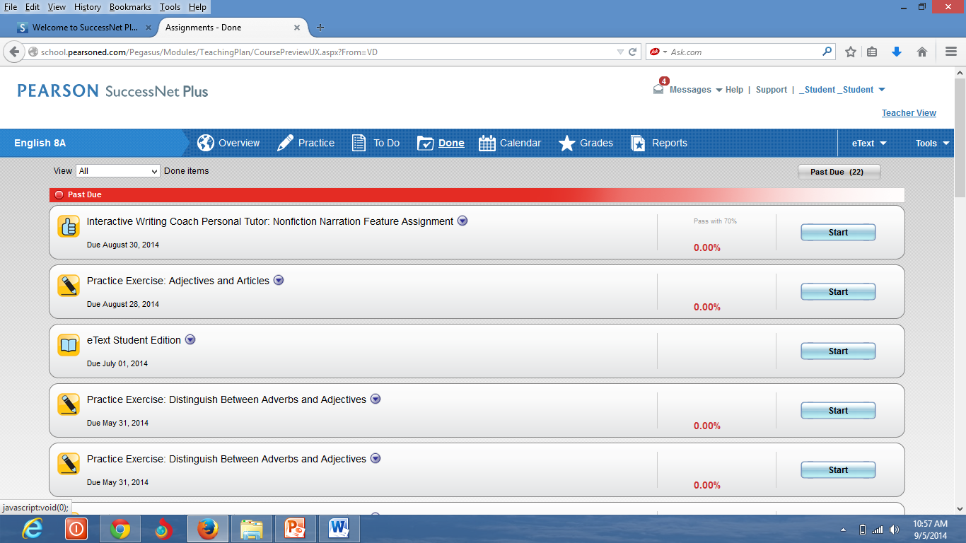
Click at “Done” to make sure that you accomplish your assignment.

Slide 21
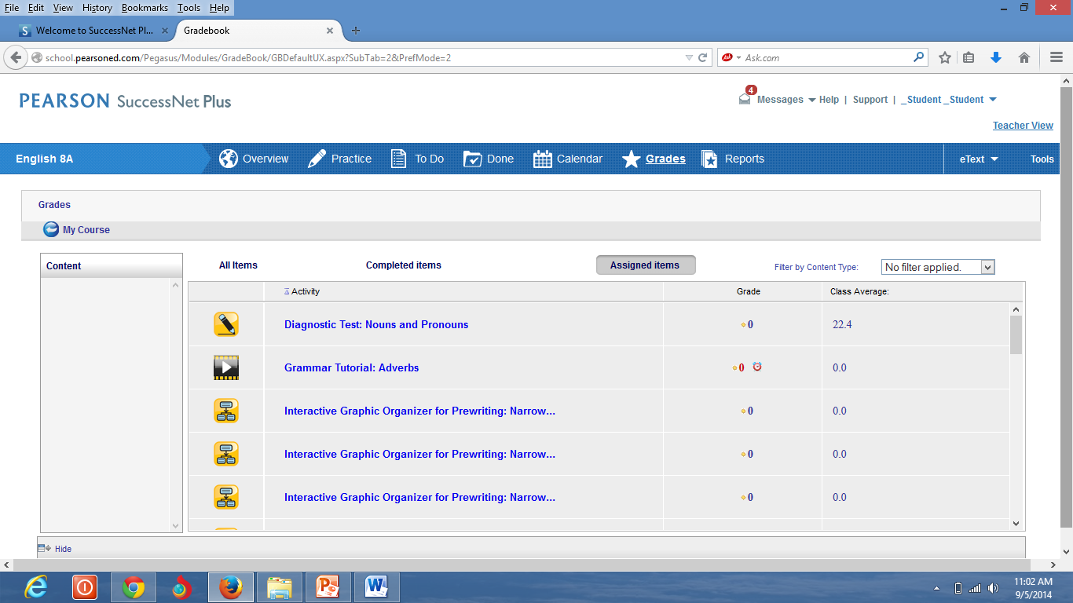
Click at “Grades” to check your grades after accomplishing your assignment.

Slide 22
Don`t forget to sign out when you finish.

