Slide 1
PEARSON REALIZE TUTORIAL
Dear Parents/Students,
Kindly follow the steps below to open your Science Interactive Pearson Online Resource.

Slide 2
How to Login
Please go to the site:
www.pearsonrealize.com

Slide 3
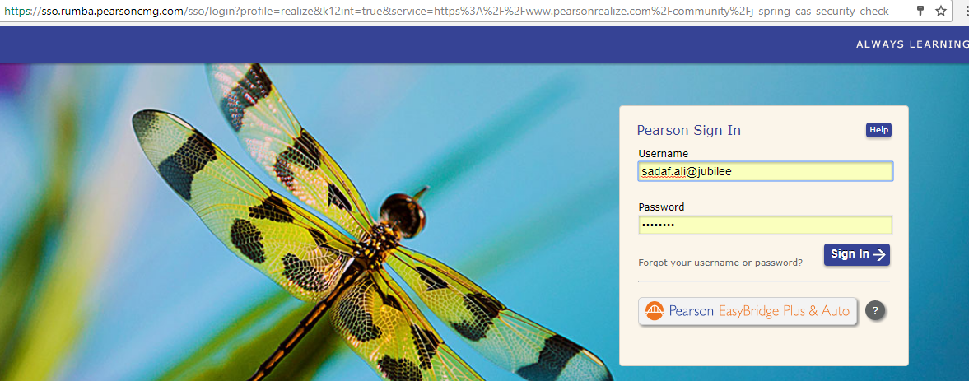
Enter username and Password in the spaces provided

Slide 4
Select English as a Language, Your preferred profile icon and press “Let’s go”

Slide 5
Your Home page will look like this. Click on Explore to access your book.

Slide 6
You will find your book here. Click on it to further explore

Slide 7
Select a chapter and click on it to get to the lessons

Slide 8
All lessons are listed as an icon

Slide 9
Click on an icon to see the topics, labs, videos etc.

Slide 10
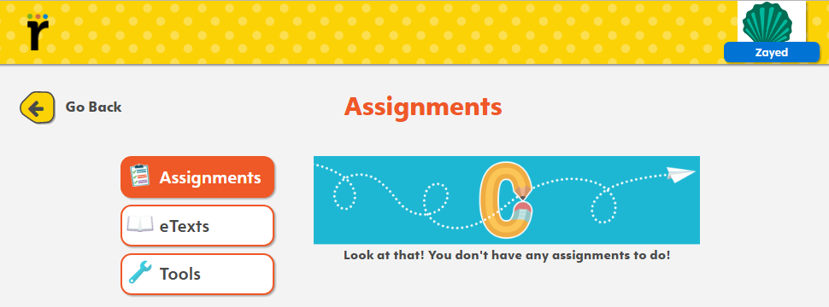
My work from your homepage gives you the following options

Slide 11
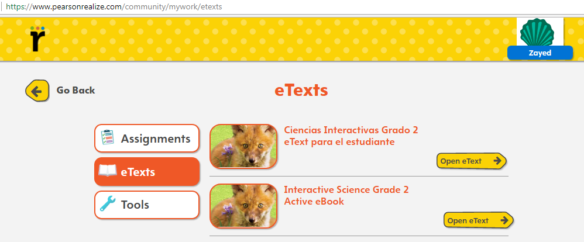
Click on e-text (English version)

Slide 12
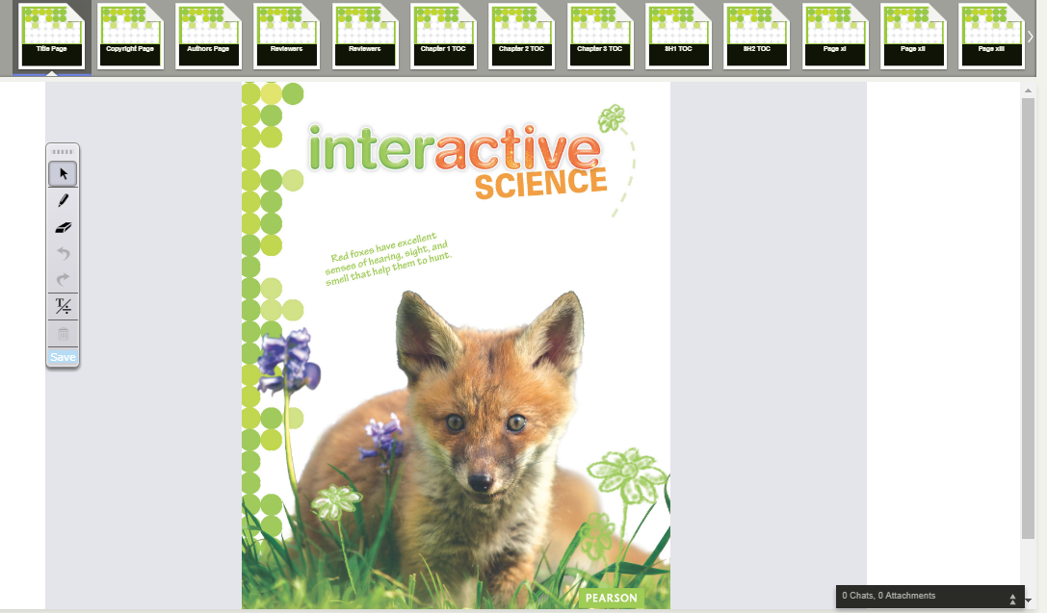
You will get to see your Interactive Science etext

Slide 13
eText

Slide 14
Assignment tab lets you see your assignments

