Slide 1
TUTORIAL FOR MATHS SITE
My.hrw.com

Slide 2
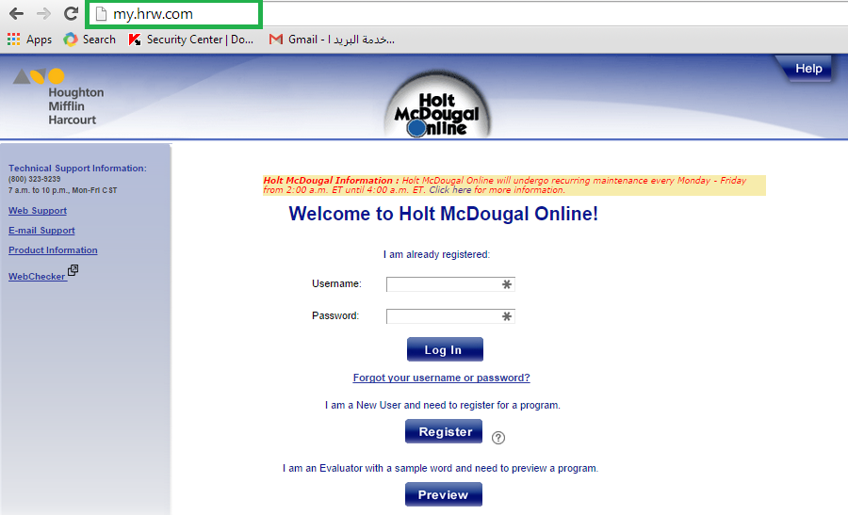
Open your browser (Google chrome or Mozilla) and type “my.hrw.com” (as in picture)

Slide 3
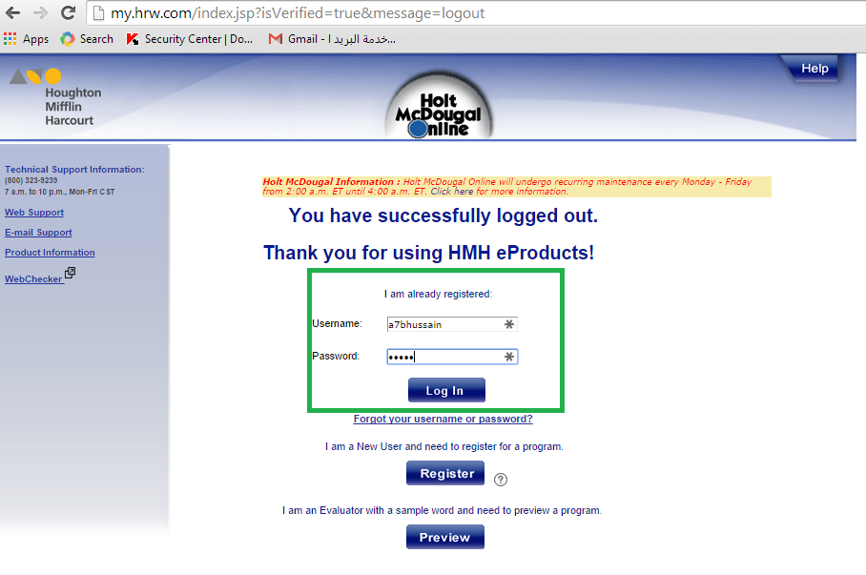
Type in your username and password in the related fields

Slide 4
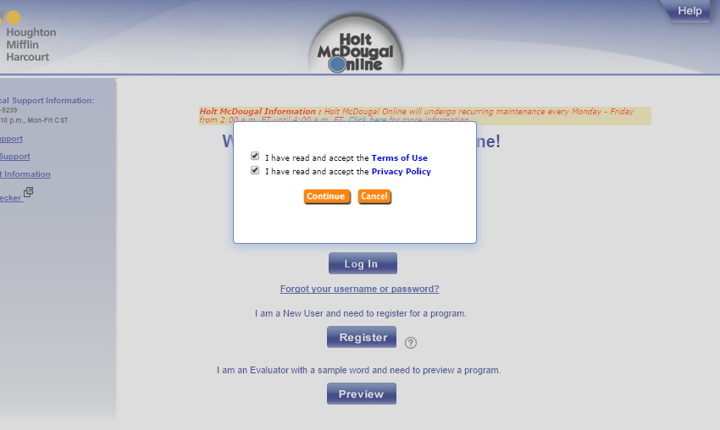
Select both check boxes and press continue as below:

Slide 5
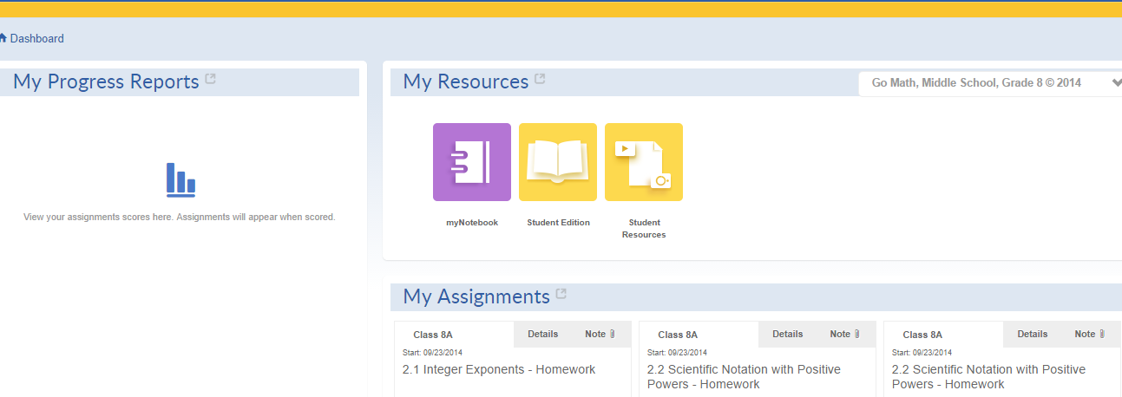
Your logon screen will appear as follows:

Slide 6
If you want to see your homework, go to “My Assignments”, do your hw as per your teachers’ instructions
For accessing your resources, press the drop down arrow on “My Resources”
Select your book and click on it to access

Slide 7
For further queries or Information, please feel free to contact us.
Thanks and Regards,
Ms. Sadaf Ali
IT Deptt.

