Slide 1
Inspection Report 2017-2018 Reflection and Next Steps

Slide 2
Band A
Good

Slide 3
Writing the SDP (School Development Plan) Together

Slide 7
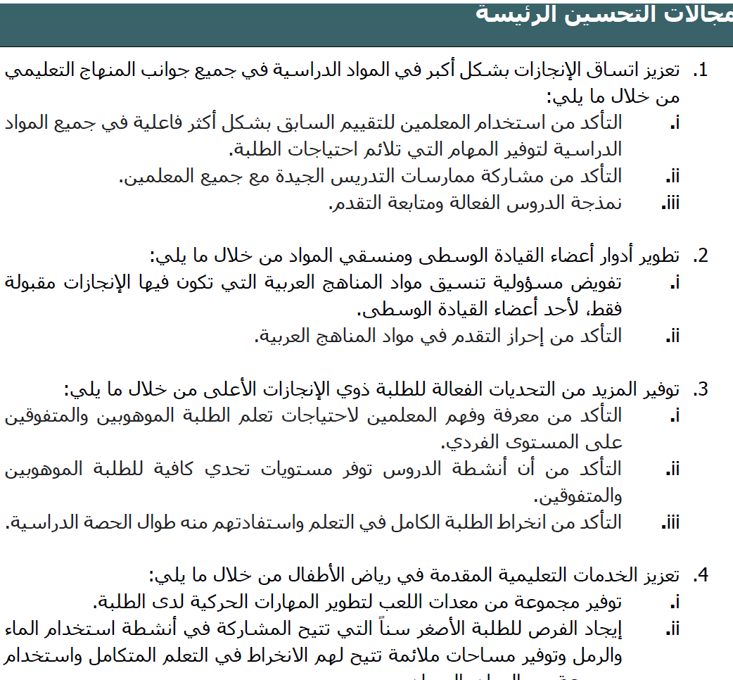

Slide 8
Work Procedure and Ground Rules:
Search
Share and respect.
Discuss.
Reflect.
Determine next steps and write them down.
Papers will be collected by the end of daily training.

Slide 10
Modelling and Monitoring Progress Activities
Modelling Definition. (Search, Share and respect, Discuss, Reflect and determine next steps(write them down)
How to model effective lesson?
How to monitor progress?

Slide 11
Assessment for Learning AfL Continuum

Slide 12
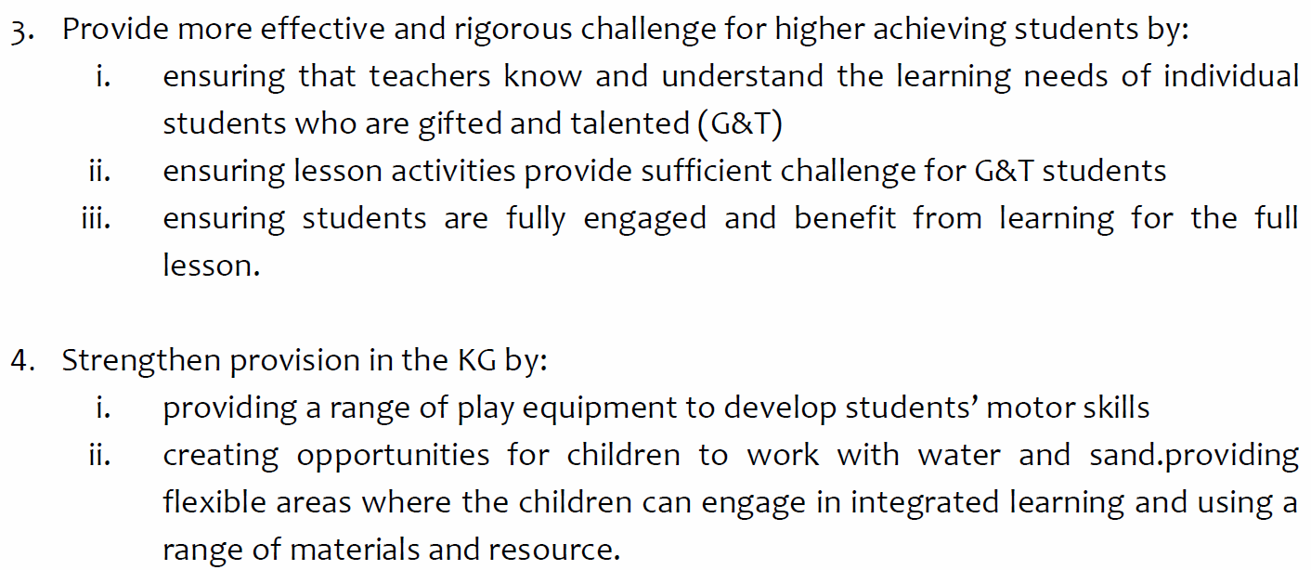

Slide 13
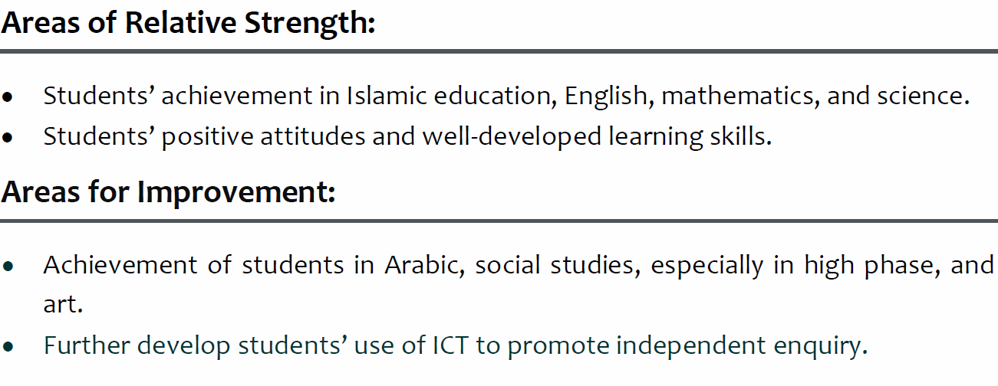
Standard 1: Students Achievement

Slide 14
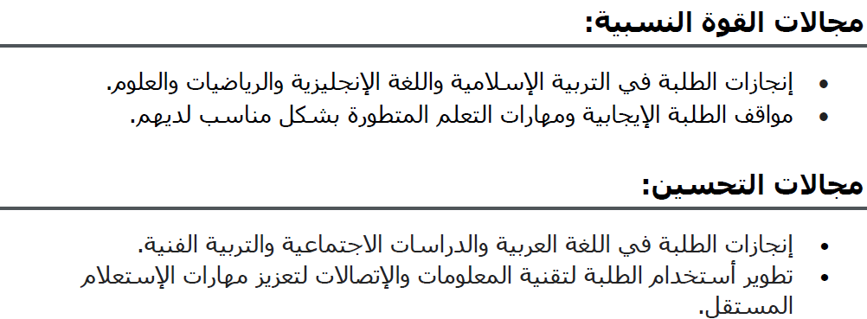
المعيار الأول:جودة التحصيل الطلابي (إنجازات الطلبة)

Slide 15
How to raise the achievement in Arabic and Social Studies especially in high phase? كيف سيتم رفع التحصيل الطلابي في اللغة العربية والمواد الاجتماعية للصفوف العليا؟

Slide 16
Achievement in Arabic and Social Studies especially in high phase
Sharing good practices.
Pairing Teachers.
Formative Assessment, Assessment for Learning Continuum.

Slide 17
How to have further development for students’ use of ICT to promote independent enquiry?

Slide 18
Standard 2: Students Personal Development

Slide 19
المعيار الثاني: التطور الشخصي والاجتماعي ومهارات الابتكار للطلاب

Slide 20
Reflection and Next Steps

Slide 21
Standard 3: Teaching and Assessment

Slide 22
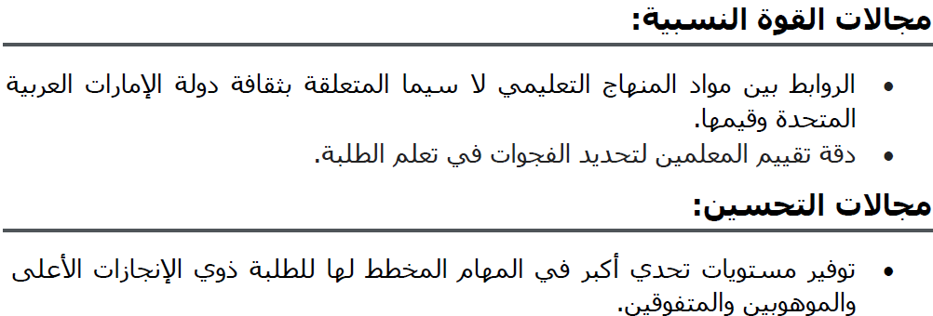
المعيار الثالث: جودة عمليات التعليم والتقييم

Slide 23
Reflection and Next Steps

Slide 24
Standard 4: Curriculum

Slide 25
المعيار الرابع: جودة المنهاج التعليمي

Slide 26
Reflection and Next Steps

Slide 27
Clubs Suggestions
Arts and Craft
Creative Writing
Cooking
Debating
Drama
Educational Trips
Elocution / Public Speaking • Gymnastics
Leadership Camps
Mural Painting
Music
Needlework
Physical Education
Projects
Reading
Team Sports
Trekking

Slide 28
Club Suggestions
Basketball Football Rugby Badminton Tennis Netball Swimming Hockey Cricket Volleyball Fitness/Yoga/Zumba
Arabic Calligraphy Indigenous Art Cross-stitch Language, Mother Tongue and Culture Clubs French Club
Chess Arts and Craft Club Computer Club Robotics Freedom Writers Educational/Strategic Games Yearbook Club Homework Club Science/Math Club
Choirs Shakespeare in the Piazza Sketch Club Comic Creators Guitar Sing-along Young Musicians Club Junior Drama Club Orchestra Jazz Band

Slide 29
How to make the extra-curricular activities effective and improve the attendance?
Clubs and Extracurricular Planning
Year, Month and Week Plan(Detailed).
Commitment.
Excitement.
Advertising.
Follow up
Encourage.
Attendance, and follow the absent students.

Slide 30
Standard 5: Protection, Care, Guidance and Support of Students

Slide 31
المعيار الخامس: جودة حماية الطلبة ورعايتهم وتقديم الإرشاد والدعم لهم

Slide 32
Reflection and Next Steps

Slide 33
Standard 6: Leadership

Slide 34
المعيار السادس: جودة قيادة المدرسة وإدارتها

Slide 35
Reflection and Next Steps

Slide 36
Thanks

