Slide 1


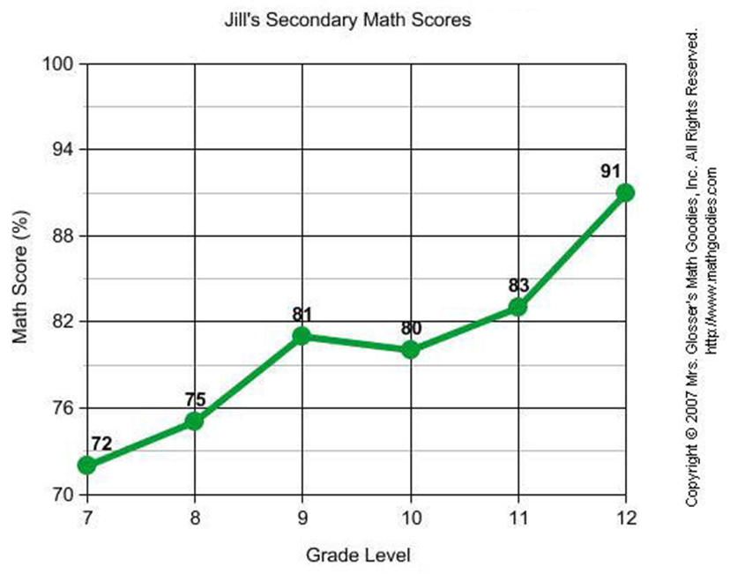

Slide 2
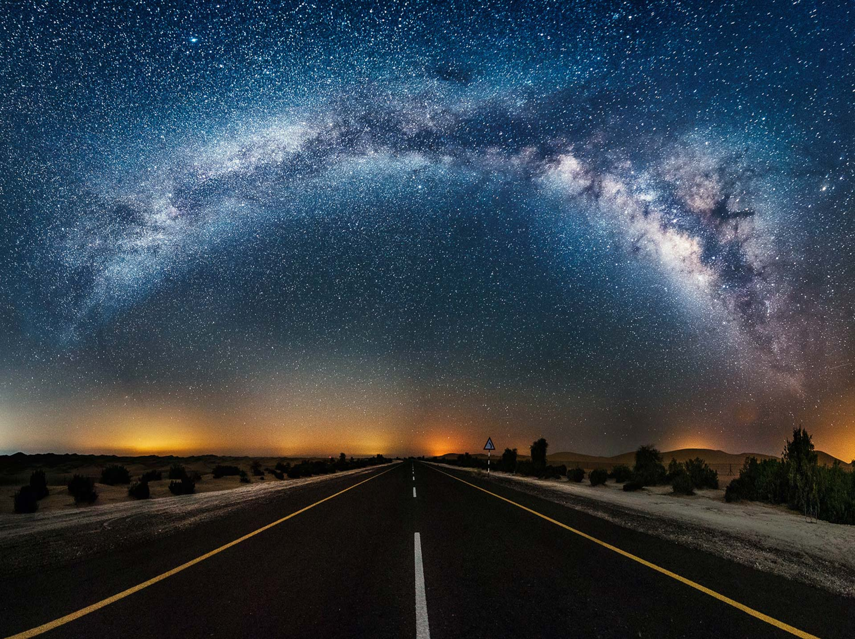

Natural hazards include large magnitudes of energy and mass, scientific notation will be used to represent vary large and very small numbers. Discussion and use of measurement units will be included in comparisons of magnitude. The following provides some examples of different types of quantities or dimensions, and the units used to label them. Most physical phenomena can be described by using the following dimensions: mass M, force F, length L, time t, and temperature T.

Slide 3

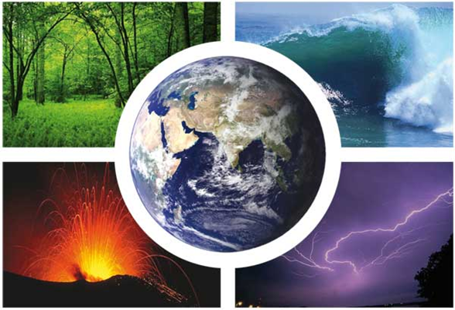
Natural Hazard
Natural hazards are naturally occurring physical phenomena caused either by rapid or slow onset events which can be geophysical (earthquakes, landslides, tsunamis and volcanic activity), hydrological (avalanches and floods), climatological (extreme temperatures, drought and wildfires), meteorological (cyclones and storms/wave surges) or biological (disease epidemics and insect/animal plagues).

Slide 4

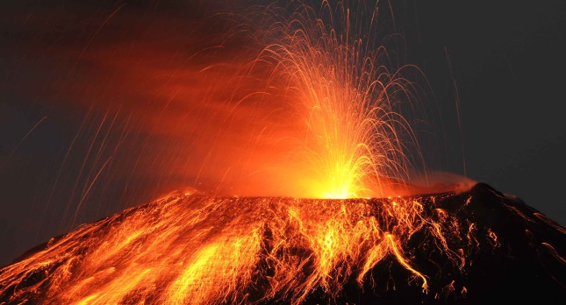
Volcano:
A volcano is "a cone shaped mountain or hill, formed by the accumulation of hardened magma" with a "hole . . . from which lava and/or hot ash and gases erupt from deep underground. Volcanoes are commonly located near subduction zones between tectonic plates. During an eruption, pyroclasitic bombs may be ejected from the volcano . A relation between the maximum distance a bomb may shoot and the initial velocity as it leaves the chute is given by the model D = v 02 / g, where D = maximum distance, g = 9.8m/s2 and v 0 = initial velocity . This model is simplified in that it assumes the bomb is ejected from the volcano at a 45o This function is quadratic, and may be used to find the distance is the velocity is known. More commonly, this relation has been used in the square root form v 0 = (gD)1/2 to estimate initial velocities of the bombs. Students will be asked to use this relation to find both the maximum distance of the projectile and the initial velocity, in different situations.

Slide 5

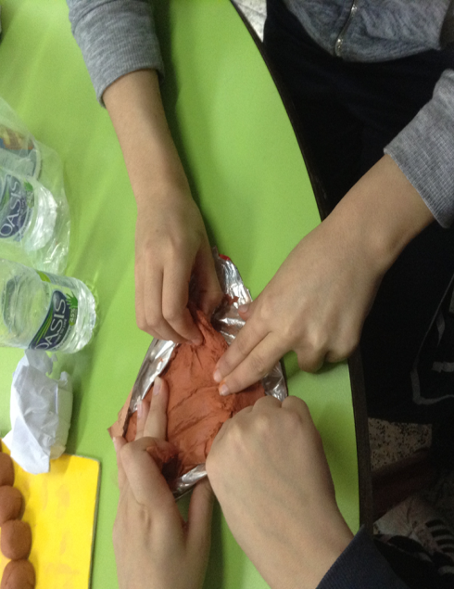
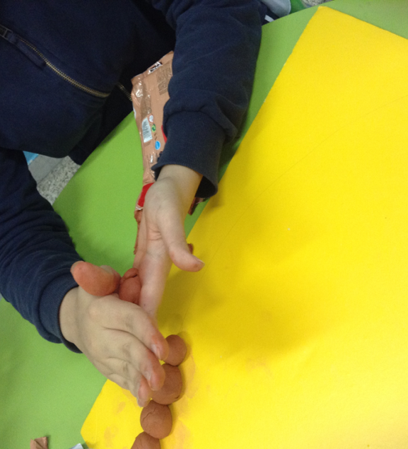
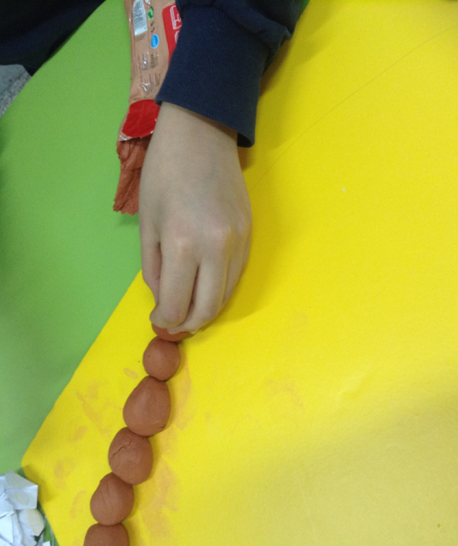
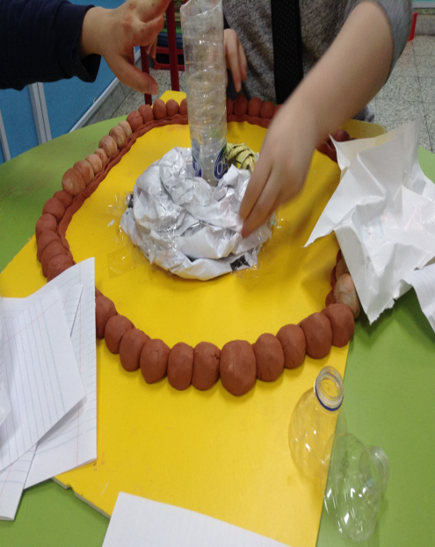
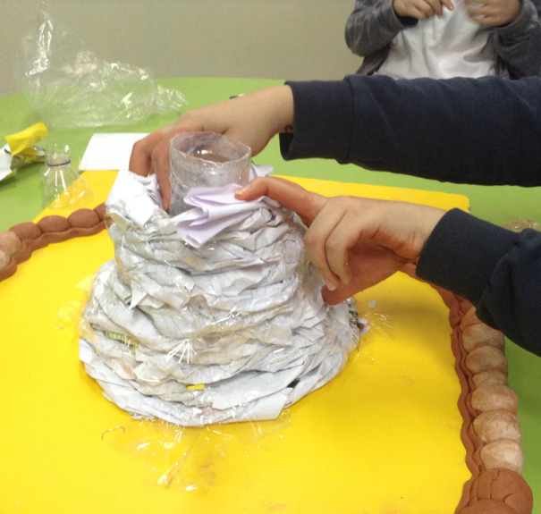
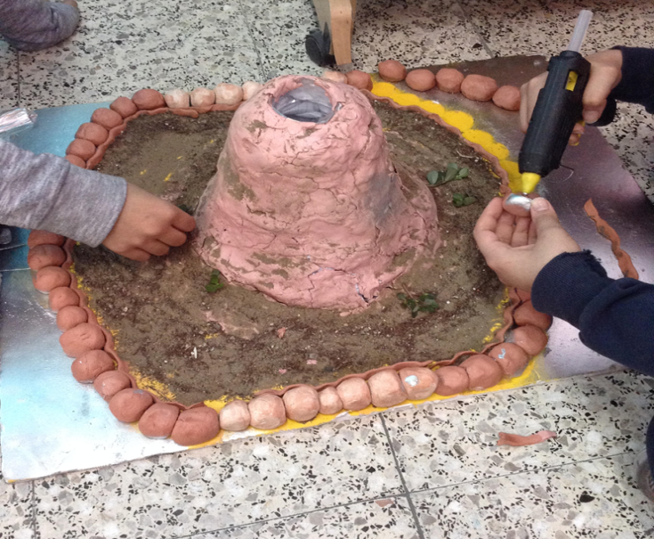
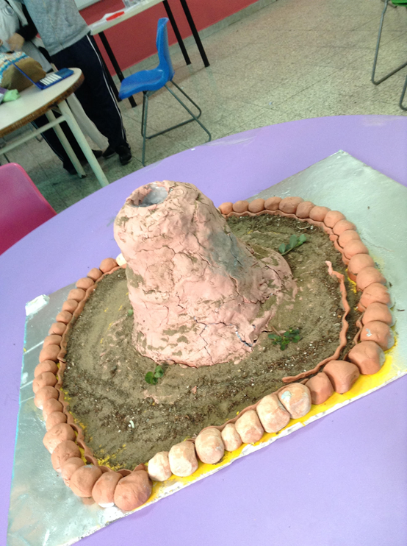
Our Hand Made Product:

Slide 6

Data of indonesia:

Slide 7
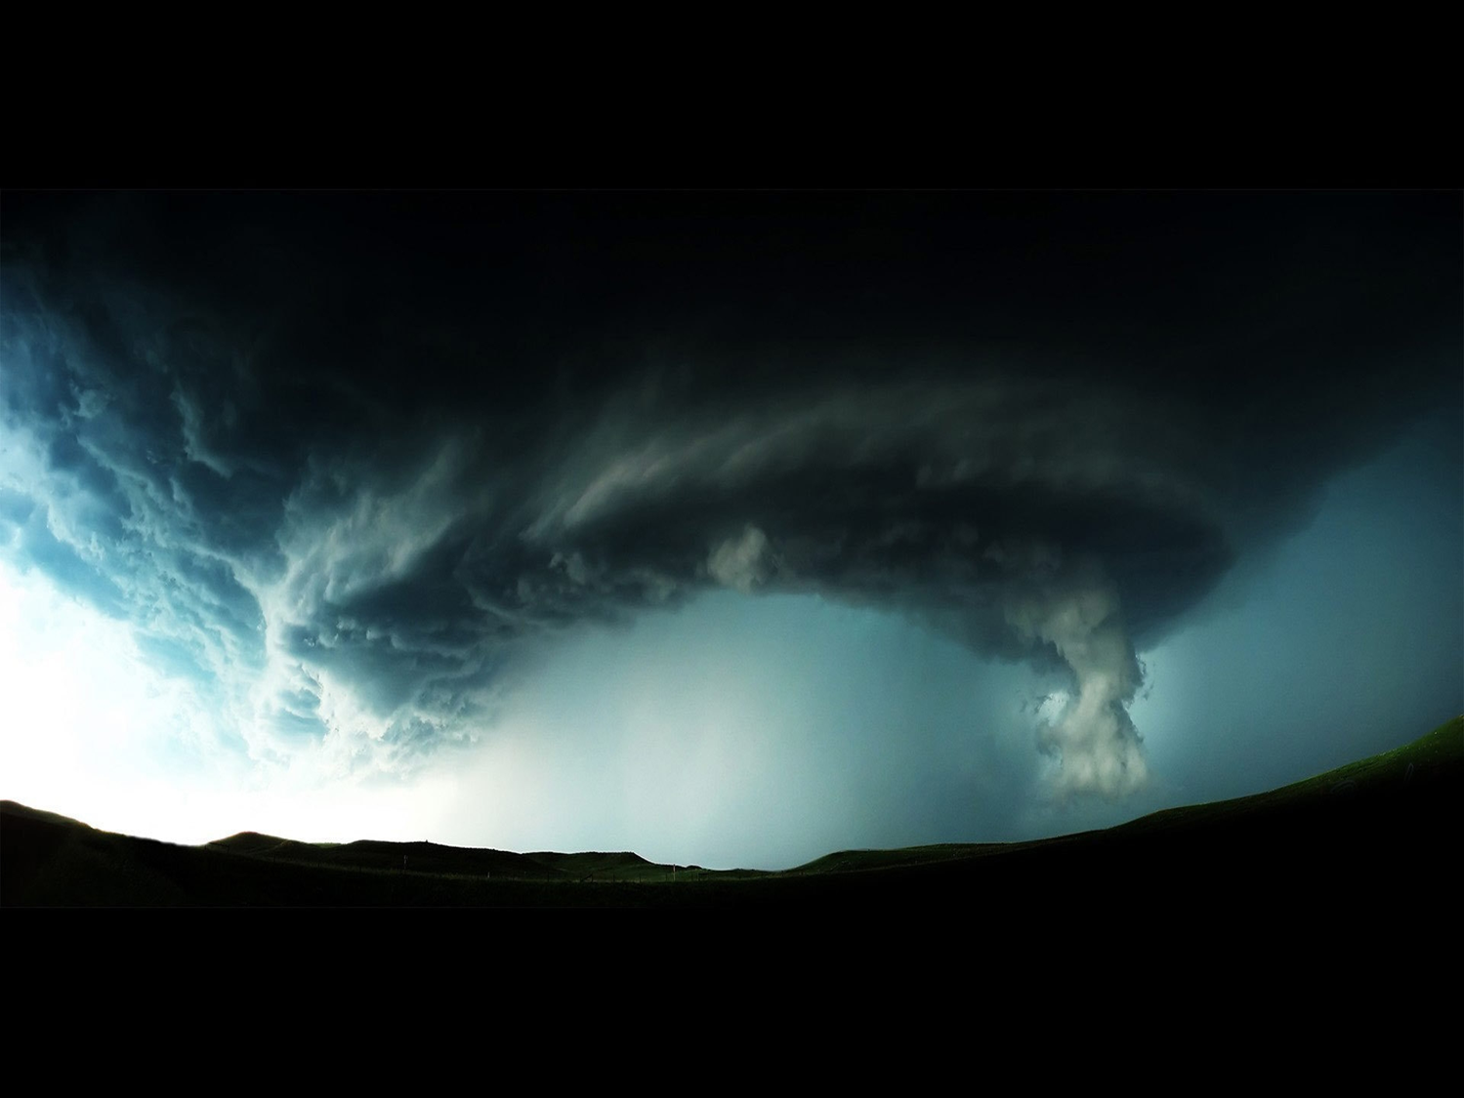
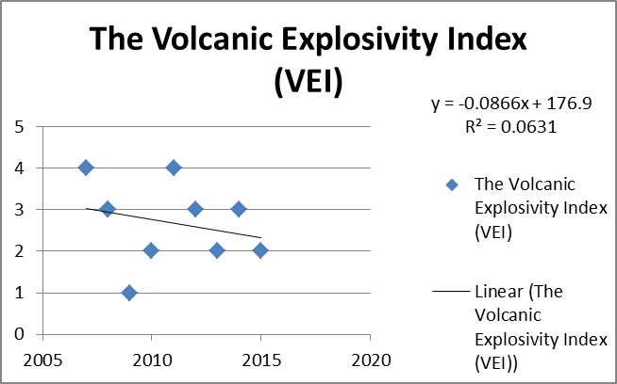
GRAPH:

Slide 8

CONCLUSION:
Based on our finding, we concluded that volcano in Indonesia is increasing and decreasing within 2007 to 2016,because the magma rises through cracks or weaknesses in the Earth's crust. When this pressure is released as a result of plate movement, magma explodes to the surface causing a volcanic eruption. The lava from the eruption cools to form new crust. Over time, after several eruptions, the rock builds up and a volcano forms.

Slide 9
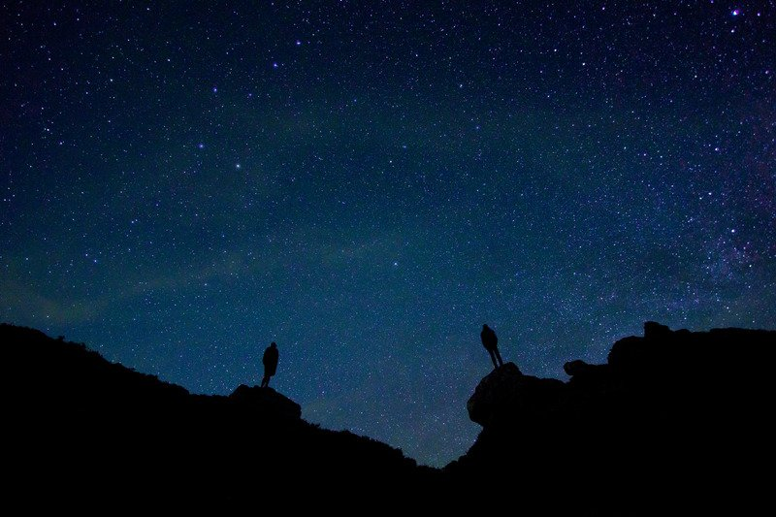
ACKNOWLEGMENT
I would first of all thank my God because without my God, I can’t do anything. Then I would like to thank my parents for supporting and helping me to do the project. Thanks to my teachers: Ms.Fayza, for everything they tried to get us to this point of our lives. And of course I would like to thank the school for giving me the chance to learn about the most detailed studies, and some main things that changed my life. Finally, my thanks go to the authors for doing so much work that I borrowed to do this big project. Because without them, I couldn’t continue my research.

Slide 10


